Slide 1
Time Series Analysis
Md. Ismail Hossain Riday

Slide 2
Time Series
Some variables are changes with the change of time
For example, change of commodity price, population, agricultural production and so on.
The arrangement of statistical data according to the change of time is known as “Time series”.

Slide 3

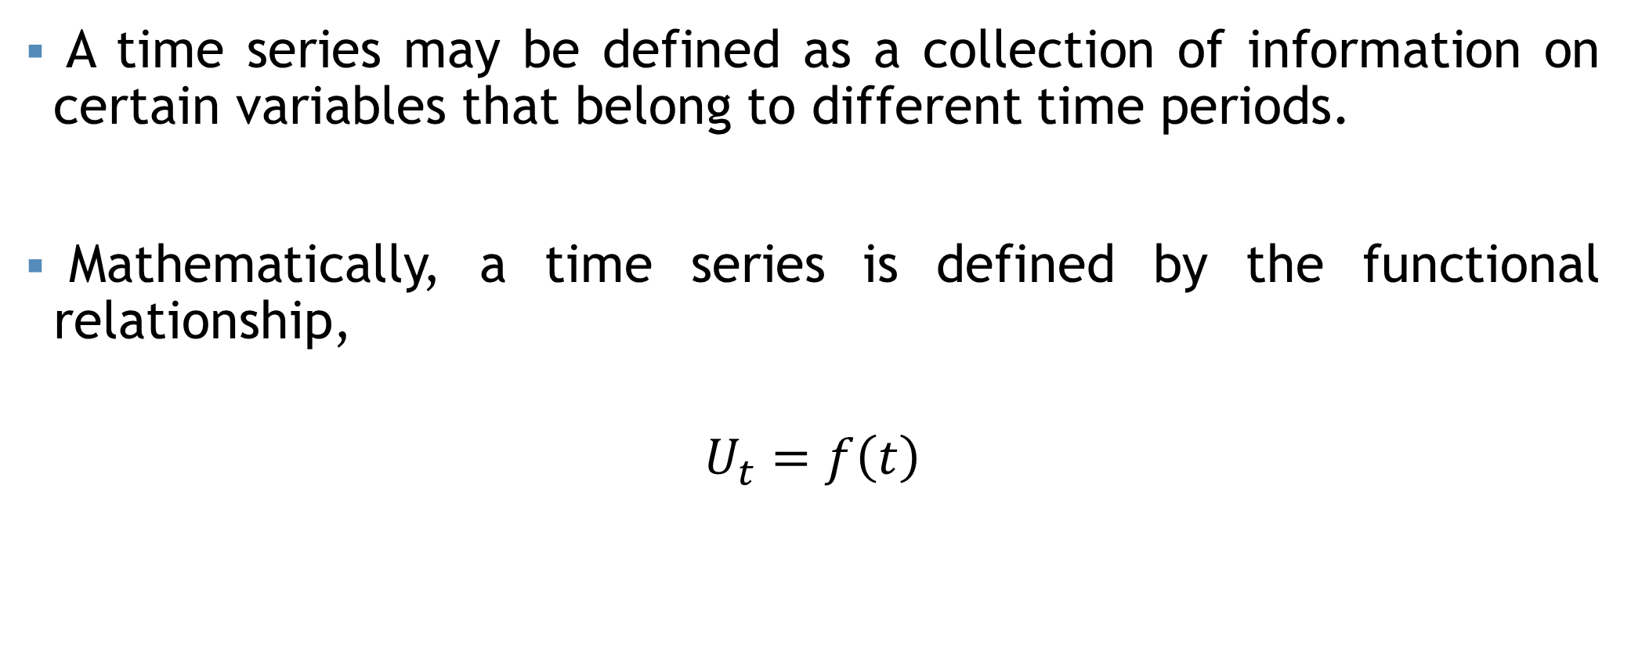



Time Series
A time series may be defined as a collection of information on certain variables that belong to different time periods.
Mathematically, a time series is defined by the functional relationship,
$$U_{t}=f\left(t\right)$$
$$t=t_{1},t_{2},…,t_{n}$$
$$U_{t}=U_{1},U_{2},…,U_{n}$$
For example, the population $\left(U_{t}\right)$ of a country in different years $\left(t\right)$
For example, the sales $\left(U_{t}\right)$ of a store in different months $\left(t\right)$

Slide 4
Why Time Series Analysis?
Studying time series helps us identify patterns and trends in data over time.
Forecast future values of variables, aiding in planning and decision-making in various domains such as finance, economics, and weather prediction.
Time series data provides insights into the effectiveness of policies and interventions over time.

Slide 5
Components
Change of data with change of time depends on a number of causes.
These causes are known as the “Components of time series”
The components of time series are:
Trend or Secular trend
Seasonal variation
Cyclical variation
Irregular variation

Slide 6
Trend/Secular Trend
Long term upward or downward tendency of a variable is knowing trend/Secular trend/Long term movement.
The aims of measurement of trend are:
To study the past behavior of the variable under consideration.
To predict or forecast the future behavior of the variable.

Slide 7
Seasonal variations
Seasonal variation means short term variation.
Time series data exhibits some changes which may be weekly, monthly, quarterly or half yearly.
This type of change may occur once or more than once within one year period.

Slide 8
Causes of Seasonal variations
There are two reasons behind the occurrence of weekly, monthly, quarterly or half yearly change within the same year:
Influence of natural forces.
Change of taste or habit.
For example, demand increases for worm cloth in the winter, air condition in the summer, umbrella in the rainy season.
For example, demand of new clothes increases at the time of religious festivals.

Slide 9
Cyclical variations
Cyclical variations are recurrent upward or downward movements in a time series but the period of cycle is greater than a year.
Once complete period is
called a “Cycle”.

Slide 10
Irregular movement
Besides trend, seasonal variation and cyclical fluctuations, there are other factors which cause variations in time series.
For example, flood, draught, earthquake, war and so on.
These variations are known as “Irregular movement”.
These factors are beyond control, unexpected and unusual.

Slide 11
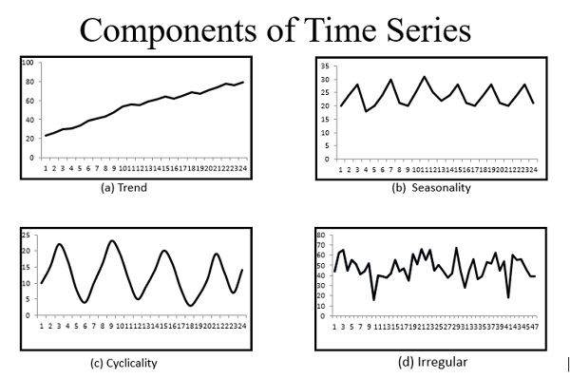

Slide 12
Models of Time Series Analysis
Some time series may not be affected by all type of variations.
Some of these types of variations may affect a few time series only.
Hence, while analyzing the time series, these effects are isolated.
In a traditional time series analysis, we assume that any given observation consists of the trend, seasonal, cyclical and irregular movements.

Slide 13


Models of Time Series Analysis
The following are the two models which we generally use for the decomposition of time series into its four components:
Additive model
Multiplicative model
$$U_{t}=T_{t}+S_{t}+C_{t}+R_{t}$$
$$U_{t}=T_{t}×S_{t}×C_{t}×R_{t}$$

Slide 14
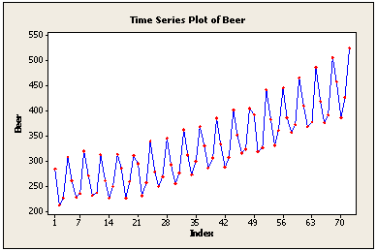
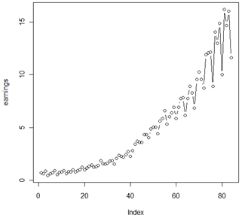
How to Choose…
The additive model is useful when the seasonal variation is relatively constant over time.
The multiplicative model is useful when the seasonal variation increases over time.

Slide 15
Basic Steps in Decomposition
The first step is to estimate the trend.
The second step is to “de-trend” the series.
Next, seasonal factors are estimated using the de-trended series.
The final step is to determine the random (irregular) component.

Slide 16
Measurement of trend
The following methods are used in measuring trend:
Graphical methods
Semi-average method
Method of moving average
Method of least square

Slide 17

Graphical method
In this methods trends are measure through graphical representation of data.
$X$ axis = Time vs $Y$ axis = Value

Slide 18
Advantages
It is the easiest method of getting quick idea of the trend.
Doesn’t require mathematical
skill.

Slide 19
Disadvantages
Trend cannot be accurately measured by this method. Different researcher gets different line.

Slide 20
Semi-average method
In this method, the whole data is divided into two parts with respect to time.
Next, we compute the arithmetic mean for each part and plot these two average against the mid-values of the respective period covered by each part.
The line obtained on joining these two points is the required trend line.

Slide 21
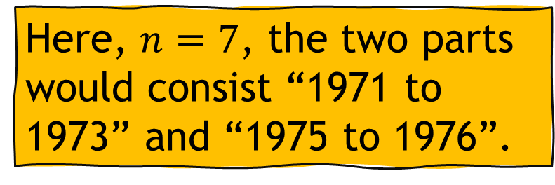
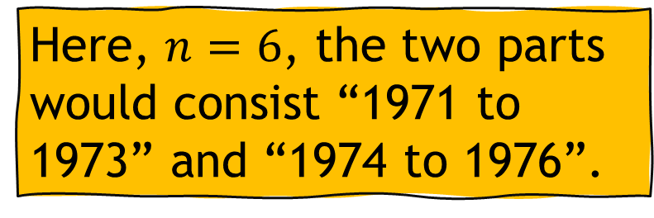
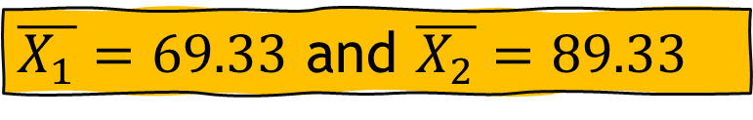
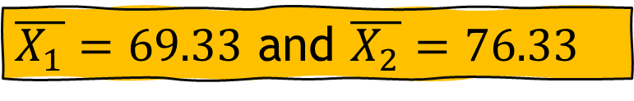
Semi-average method
Year | Bank clearances
1971 | 53
1972 | 79
1973 | 76
1974 | 66
1975 | 69
1976 | 94
1977 | 105
Year | Bank clearances
1971 | 53
1972 | 79
1973 | 76
1974 | 66
1975 | 69
1976 | 94
1974 being omitted
Here, $n=6$, the two parts would consist “1971 to 1973” and “1974 to 1976”.
Here, $n=7$, the two parts would consist “1971 to 1973” and “1975 to 1976”.
$\overline{X_{1}}=69.33$ and $\overline{X_{2}}=76.33$
$\overline{X_{1}}=69.33$ and $\overline{X_{2}}=89.33$

Slide 22
Semi-average method
Disadvantages: Arithmetic mean is affected by extreme values.

Slide 23
Moving average
The data on the rice production during 1980-90 in a certain region are given bellow:
Year | Production
1980 | 280
1981 | 300
1982 | 325
1983 | 420
1984 | 315
1985 | 360
1986 | 400
1987 | 450
1988 | 350
1989 | 420
1990 | 460
Determine the trend using 4-year cycle period.

Slide 24
Moving average
Year | Production
1980 | 280
1981 | 300
1982 | 325
1983 | 420
1984 | 315
1985 | 360
1986 | 400
1987 | 450
1988 | 350
1989 | 420
1990 | 460
4 year moving total
4 year moving avg.
Centralized
1325
331.25
335.63
1360
340.00
347.50
1420
355.00
364.38
1495
373.75
377.50
1525
381.25
385.63
1560
390.00
397.50
1620
405.00
420.00
412.50
1680

Slide 25
Moving average

Slide 26






Method of Least Square
Let the model of the trend in the time series showing the relationship between the variables be:
$$Y=α+βX+ε$$
$$\hat{β}=\frac{∑XY−\frac{∑X∑Y}{n}}{∑X^{2}−\frac{{\left(∑X\right)}^{2}}{n}}$$
$$\hat{α}=\overline{Y}−\hat{β}\overline{X}$$
$$\hat{Y}=\hat{α}+\hat{β}X$$
$$\hat{β}=\frac{∑XY}{∑X^{2}}$$
$$\hat{α}=\overline{Y}$$

Slide 27

Method of Least Square
Estimation of trend of 7 years rice production in a certain district by the MLS:
Year | Production
1980 | 87
1981 | 98
1982 | 104
1983 | 95
1984 | 101
1985 | 108
1986 | 100
Time (Year, Week, Quarter, etc.) = t
Function of time = Y
When the number of years is even:
$$X=2×\left(t−\overline{t}\right)$$
When the number of years is odd:
$$X=\left(t−\overline{t}\right)$$

Slide 28
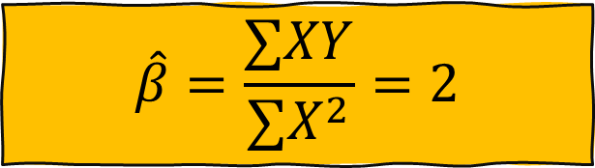
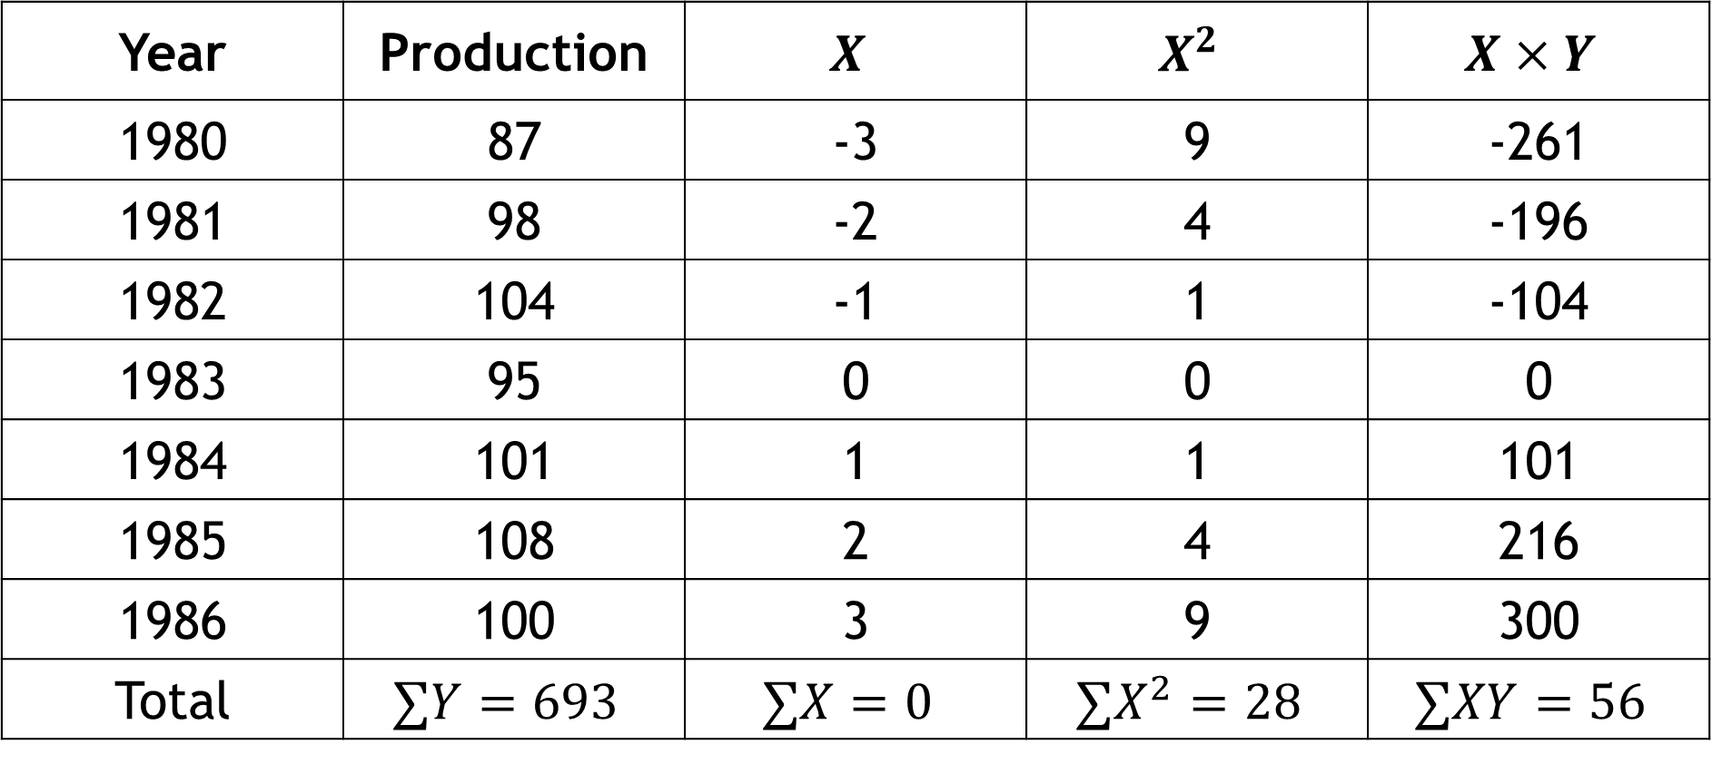


Method of Least Square
Year | Production | $$X$$ | $$X^{2}$$ | $$X×Y$$
1980 | 87 | -3 | 9 | -261
1981 | 98 | -2 | 4 | -196
1982 | 104 | -1 | 1 | -104
1983 | 95 | 0 | 0 | 0
1984 | 101 | 1 | 1 | 101
1985 | 108 | 2 | 4 | 216
1986 | 100 | 3 | 9 | 300
Total | $$∑Y=693$$ | $$∑X=0$$ | $$∑X^{2}=28$$ | $$∑XY=56$$
$$\hat{β}=\frac{∑XY}{∑X^{2}}=2$$
$$\hat{α}=\overline{Y}=99$$
$$\hat{Y}=99+2X$$

Slide 29

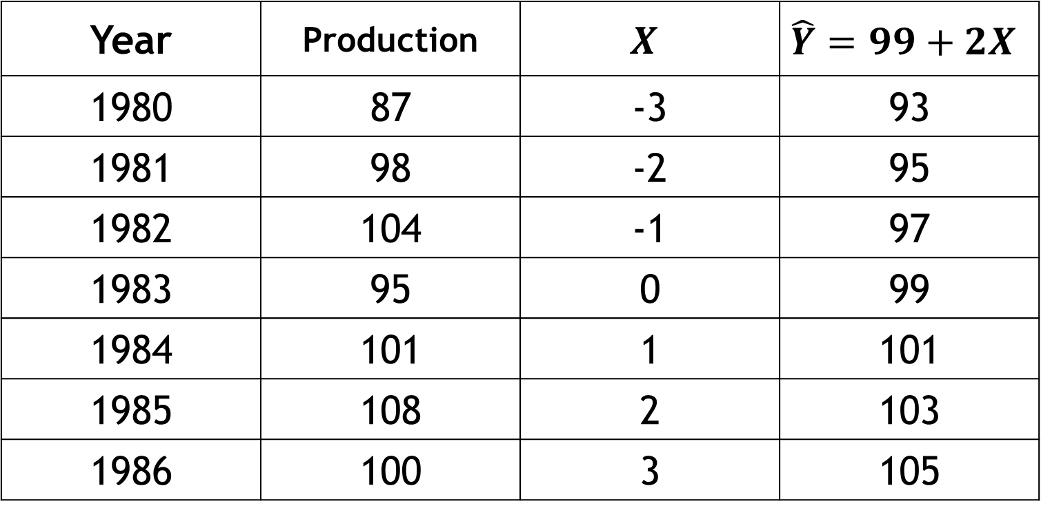
Method of Least Square
$$\hat{Y}=99+2t$$
Year | Production | $$X$$ | $$\hat{Y}=99+2X$$
1980 | 87 | -3 | 93
1981 | 98 | -2 | 95
1982 | 104 | -1 | 97
1983 | 95 | 0 | 99
1984 | 101 | 1 | 101
1985 | 108 | 2 | 103
1986 | 100 | 3 | 105

Slide 30


Method of Least Square
$$\hat{Y}=99+2t$$
Prediction the production value for year 1978 and 1989:
For year 1978: X = -5
$${\hat{Y}}_{1978}=99+\left(2×−5\right)=???$$
For year 1989: X = 6
$${\hat{Y}}_{1989}=99+\left(2×6\right)=???$$

Slide 31
Mathematical exercise
To access additional mathematical problems, please refer to the PDF lecture notes.

Slide 32
Thank You

